Slide 1
Disability Rights Movement
Danielle Keller
National Louis University

Slide 2
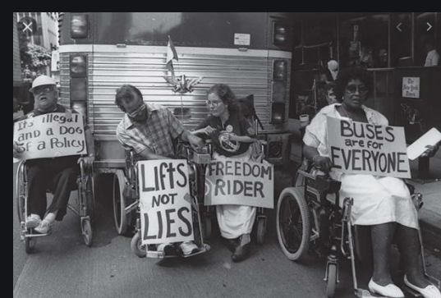
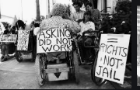
The US in 1960’s and 1970s
The 1960s and 1970s were a time of political revolution.
The political, social and economic environment was tense.
This was an awakening era against social injustices and inequities.
The Civil Rights Movements were carrying out vehement advocacy and rigorous protest for equal rights for minority groups, individuals with disabilities and marginalized groups.

Slide 3
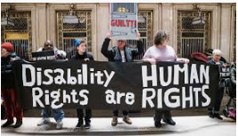
Triggers of the protests
There had been marginalization of the individuals with disabilities.
These individuals and had been left out and discriminated against not only in the American Community but also in the policy making framework.
Additionally, being equal humans their quest was to be empowered enough to take control of their lives.
They sought amendment of the Rehabilitation Act Title VII, Chapter 1, and Section 701 to protect them better(Winter,2003).

Slide 4

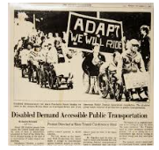
Important figures in the Disability Rights Movement
Rights activism is mostly stewarded by determined individuals.
Ed Roberts and John Hessler are figures that go down in history for fighting for the rights of individuals living with disabilities(NPS,2019).
Despite being college students they achieved several milestones.
They founded Disability Rights Movement groups such as :
    Disability Rights Education and Defense Fund
    Americans Disabled for Accessible Public Transportation,
    Centre for Independent Living

Slide 5
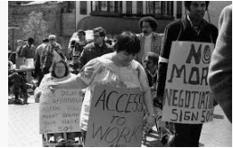
Ethical issues that sparked the Disability Rights Movement
Culture entails a people’s way of life, their perceptions, beliefs, norms, stereotypes and prejudices.
The American society hardly appreciated cultural diversity.
There were widespread prejudices about people with disabilities.
First, they were perceived as inferior to the rest of the society.
Secondly, the society undermined them, often taking them as idiots and lunatics.
Out of these prejudices, they were hardly considered in education and literacy programs.
Consequently they didn’t have jobs and could hardly fend for themselves.
The community had turned them into a liability and one they kept complaining about(McDermott,1995) .
Even some of the religious groups considered them a curse, especially the mentally impaired.

Slide 6
Perspectives of the Disability Rights Movement
1. The Medical Model
This model created an understanding that disability was reparable through medical intervention(Brisenden,1986) .
Also, it is possible to integrate individuals with disabilities into the society.
Opposition to the model
It turned out oppressive
The community discriminated against the individuals and viewed them as less capable .
2. The Social Model
This model was meant to solve the problems of the medical model.
Its main facets were disability as a social creation and construction.
It was to clear the notion that disability is a condition resulting from impairment and needs to be tolerated.
Instead, it was an eye opener on the society that : disability is a problem they create by disregarding those with disabilities(Shakespeare,1997).

Slide 7
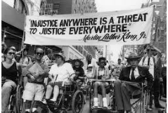
Historical movements that supported Disability Rights Movement
The grievances of the Civil Rights Movement(CRM) helped to forge forward the Disability Rights Movement.
CRM championed for laws to protect minority groups which includes individuals with disabilities against marginalization, segregation and oppression(Scotch,1989).
Just like the Disability Rights Movement, CRM sought inclusivity in political, education and economic sectors.
A remarkable milestone for the Disability Rights Movement achieved through CRM was attained from the suit Brown v. Board of Education.

Slide 8
Making a Difference
The world will not be changed by aliens, any individual, you or me , anyone with the will and clear goal can create the difference everyone longs for.
I believe in equity and fair treatment of every human being regardless of their cultural background, strong appreciation of cultural diversity and the beauty of uniqueness in individuals.
To initiate change, one has to understand the issue, strategize then execute their change plan.
To achieve these, one has to be able to communicate the need for change and associate it with the immediate environment, collaborate with other stakeholders to execute the change process and importantly commit to the plan with resilience and persistence.

Slide 9
My Change Plan
I plan to create a difference in how street children are treated. I plan to mobilize my friends and their friends to educate the society on the need to empathize with street children and appreciate their talents.
Ed Roberts and John Hessler are an inspiration to me and my plan.
I am proud of their resilience and will to bit the odds and stand for what they believed in: disability is not inability.
Similarly, no one chooses the family they are born, neither the events in their upbringing. Being less fortunate and homeless is not a crime.
The determination of Ed Roberts and John Hessler motivates my will to fight for societal acceptance for street children against the opposition that they are delinquent, criminals from whom nothing good can come from.
Street children suffer
They need love
They need empathy

Slide 10
References
NPS. (2019 December, 13). “Disability History: The disability rights movement.” National Park Service (Online), https://www.nps.gov/articles/disabilityhistoryrightsmovement.htm#:~:text=The%20disability%20rights%20movement%20continues,employment%20during%20the%20Great%20Depression.
Winter, J. A. (2003). The development of the disability rights movement as a social problem solver. Disability Studies Quarterly, 23(1).
Brown v. Board of Education, 347 U.S. 483, 74 S. Ct. 686, 98 L. Ed. 873 (1954).
Fleischer, D. Z., Zames, F. D., & Zames, F. (2012). The disability rights movement: From charity to confrontation. Temple University Press.
Scotch, R. K. (1989). Politics and policy in the history of the disability rights movement. The Milbank Quarterly, 380-400.
Shakespeare, T., & Watson, N. (1997). Defending the social model. Disability & Society, 12(2), 293-300.
Brisenden, S. (1986). Independent living and the medical model of disability. Disability, Handicap & Society, 1(2), 173-178.
McDermott, R., & Varenne, H. (1995). Culture as disability. Anthropology & Education Quarterly, 26(3), 324-348.

